Slide 1
The ELK Stack
ElasticSearch, LogStash, and Kibana
Notes:
resource:
- https://speakerdeck.com/elasticsearch/introduction-to-elasticsearch-logstash-and-kibana
- http://www.elasticsearch.org/blog/significant-terms-aggregation/
- http://www.elasticsearch.org/videos/using-elasticsearch-logstash-kibana-techologies-centralized-viewing-logs-bloomberg/

Slide 2
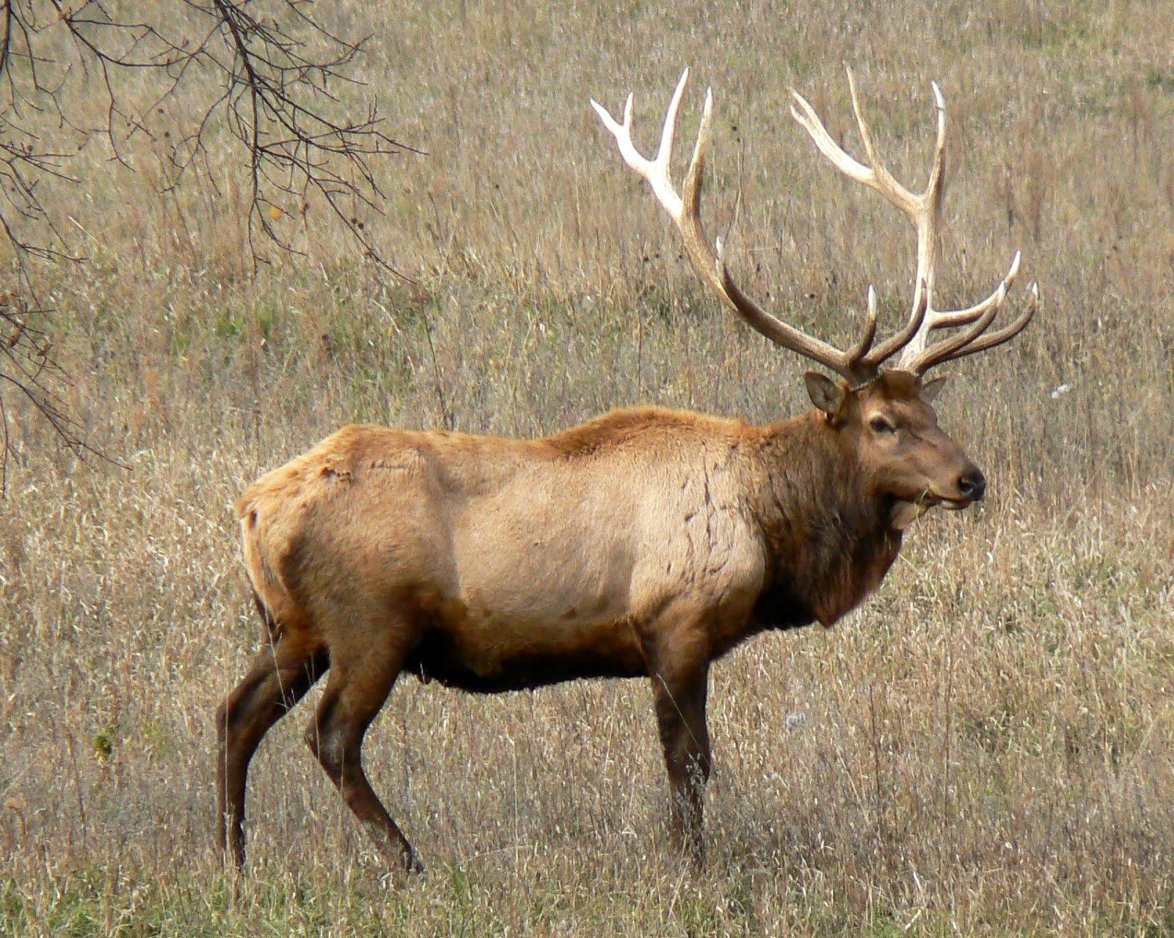

Slide 3

What is
Schema-less
Distributed
REST-ful, Document-oriented, and speaks JSON
For searching and analytics
and more...

Slide 4
Architecture
Built on top of Apache Lucene
Runs on the JVM
Distributed in nature - cluster can have data, master or load balancing nodes
Highly available and fault tolerant

Slide 5
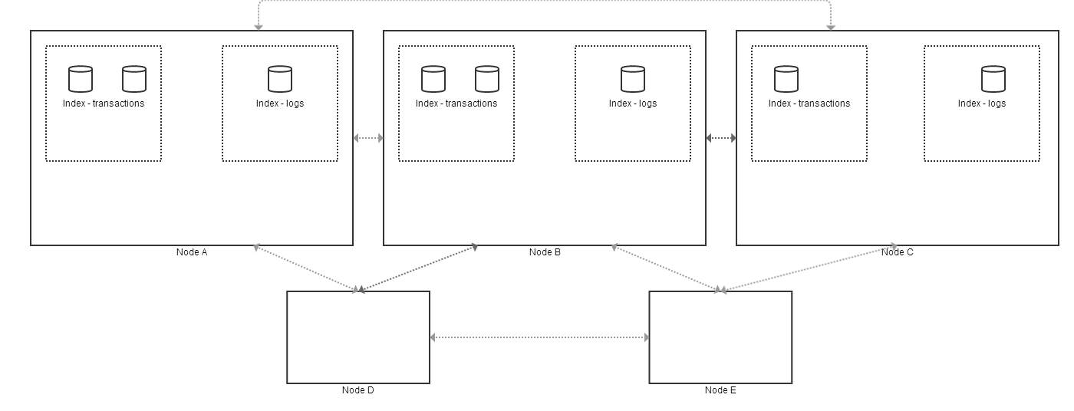
Legend
Shard
Index
Node (instance of ElasticSearch process)

Slide 6
ElasticSearch - document oriented
- and schema-less
Movies example…
index a document (PUT and POST)
check for existence of a document
retrieve fields
delete
update
update with optimistic concurrency
update partial
upsert
Notes:
- every field in a document is indexed in elasticsearch by default (inverted index created for fast lookup)

Slide 7
ElasticSearch - Distributed
Start a node - open Marvel
Data is allocated within the node
Start another node
Highlight data being redistributed to the new node
Discovery mechanisms - multicast vs. unicast
Master election, sharding

Slide 8
ElasticSearch - RESTful
Get index stats - number of shards (partitions of data), replicas, state and size
Get cluster health - overall health status, number of shards and nodes
Get cluster state - metrics of all indices, settings and mappings of all indices, some metrics, info on all shards in all indices

Slide 9
ElasticSearch - Concepts
Index - highest level bucket to store documents, indicates some physical storage
Type
Relational DB ⇒ Databases ⇒ Tables ⇒ Rows ⇒ Columns
Elasticsearch ⇒ Indices ⇒ Types ⇒ Documents ⇒ Fields
Mapping - the definition of a type (think schema) and how ElasticSearch should analyze, parse and store the fields of this type
Analysis:
first, tokenizing a block of text into individual terms suitable for use in an inverted index,
then normalizing these terms into a standard form to improve their “searchability” or recall.
Notes:
analysis - things like lowercase, stemming, etc…
tokenizing - could use n-gram filter and edge gram filters

Slide 10
ElasticSearch - search and analytics
Search
Structured search - working with exact values, between date ranges, numbers, enumerated strings, etc...
Full-text search - natural language and other text, relevance is usually concern here instead of exact matches
Notes:
http://www.elasticsearch.org/blog/significant-terms-aggregation/

Slide 11
ElasticSearch - search in depth
Analyzes all documents and keeps an inverted index data structure for fast matching
Notes:
http://www.elasticsearch.org/blog/significant-terms-aggregation/

Slide 12
Inverted index example
Document: “The quick brown fox jumped over the lazy dog.”
Term | Doc 1 |
--------------------------
The | x |
quick | x |
brown | x |
fox | x |
jumped | x |
over | x |
the | x |
lazy | x |
dog | x |
Notes:
http://www.elasticsearch.org/blog/significant-terms-aggregation/

Slide 13
Inverted index example
Document: “The quick brown fox jumped over the lazy dog.”
Document: “Quick, the fox, was lazy.”
Term | Doc 1 | Doc 2 |
--------------------------
The | x | |
quick | x | |
brown | x | |
fox | x | x |
jumped | x | |
over | x | |
the | x | x |
lazy | x | x |
dog | x | |
Quick | | x |
was | | x |
Notes:
http://www.elasticsearch.org/blog/significant-terms-aggregation/

Slide 14
ElasticSearch - Query DSL
Simple search
Compound search
Query vs. Filters
Range filter
Aggregations
Significant terms (‘the uncommonly common’)
Notes:
http://www.elasticsearch.org/blog/significant-terms-aggregation/

Slide 15
ElasticSearch - search examples
NFL data - fuzzy description, more like this
NFL data - bool query
NFL data - all IND offense
NFL data - aggregations - average down and distance, 2nd half yard to go
Notes:
http://www.elasticsearch.org/blog/significant-terms-aggregation/

Slide 16
ElasticSearch - search examples
NFL 2013 data - get touchdowns by quarter
NFL 2013 data - get significant terms in description by teams
Notes:
http://www.elasticsearch.org/blog/significant-terms-aggregation/

Slide 17
ElasticSearch - Demo Charting App
NFL Viz: https://github.com/mradamlacey/nfl-viz
Notes:
http://www.elasticsearch.org/blog/significant-terms-aggregation/

Slide 18

What is LogStash
Data import/export tool for time series and log data
Design inspired by Unix utilities which pipe in/out to each other
Notes:
http://tech.paulcz.net/ACUG-Logstash/

Slide 19
What problem does it solve?
How to parse and analyze log data from many sources?
Mar 12 12:00:08 server2 rcd[308]: Loaded 12 packages in 'ximian-red-carpet|351' (0.01878 seconds)
[2014-05-06 08:04:00.333] [ERROR] - core - bad thing happened
[Wed Oct 11 14:32:52 2000] [error] [client 127.0.0.1] client denied by server configuration: /export/home/live/ap/htdocs/test
Notes:
http://tech.paulcz.net/ACUG-Logstash/

Slide 20
LogStash - example use cases
Import of JSON to ES by dropping files into a folder
Parse webserver access files across multiple servers, calculate response times and chart
Parse application logs and send emails when an error occurs
Stream application log data across many servers to a single log dashboard
Drop a file into a folder to be ingested and aggregated into centralized log database
Notes:
http://tech.paulcz.net/ACUG-Logstash/

Slide 21
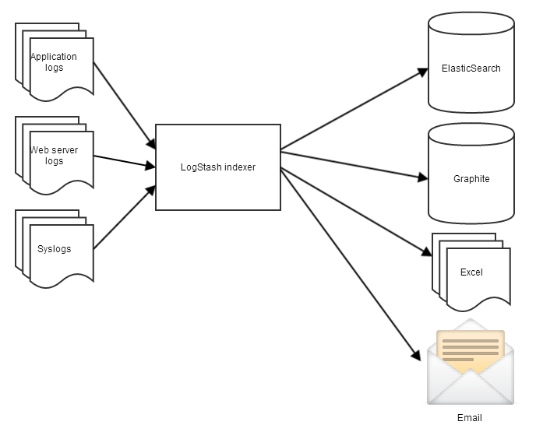
Notes:
http://tech.paulcz.net/ACUG-Logstash/

Slide 22
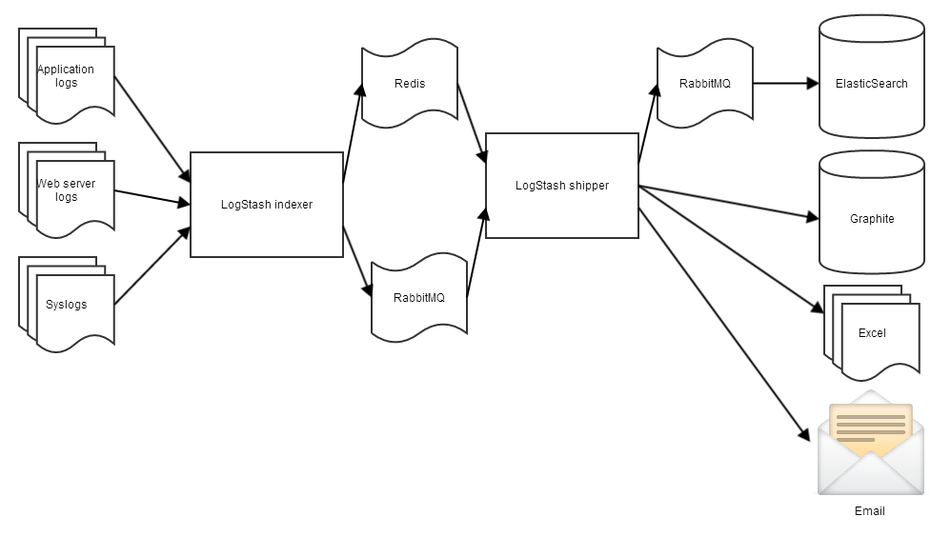
Notes:
http://tech.paulcz.net/ACUG-Logstash/

Slide 23
LogStash - example configuration
input
filter
output

Slide 24
LogStash - demo
output CPU load to CSV (load-avg.conf)
Stream tweets to ElasticSearch (twitter.conf)
Parse NodeJS server logs to ElasticSearch (mp.conf)

Slide 25

What is Kibana
Dashboard tool for data in ElasticSearch
Highly configurable/customizable, build panels with user defined charts, tables, etc...
Built on AngularJS

Slide 26
Kibana - demos
NFL stats dashboard
Tweets dashboard
ElasticSearch Marvel

Slide 27
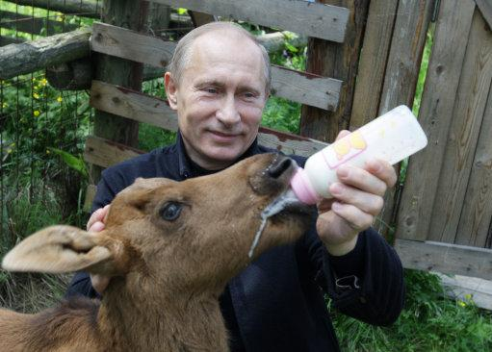
https://github.com/mradamlacey/elk-stack-presentation
Notes:
Putin feeding a baby elk

Slide 28
Sources
ElasticSeach - The Definitive Guide: http://www.elasticsearch.org/guide/en/elasticsearch/guide/current/
LMAO If you don’t LogStash: http://tech.paulcz.net/ACUG-Logstash
Quick ELK Demos: https://github.com/kurtado/quick-elk
Notes:
Putin feeding a baby elk

